Slide 1
Interim Report January–December 2014
Vaisala Corporation
February 12, 2015

Slide 2
Overview of Q4/2014
Orders received EUR 87.1 (82.7) million, +5%
Order book EUR 129.2 (122.0) million, +6%
Net sales EUR 95.7 (80.5) million, +19%
Gross margin 52.5% (48.7%)
Operating result EUR 14.9 (3.1) million, +388%
Earnings per share EUR 0.73 (0.10)
Cash and cash equivalents EUR 47.6 (45.8) million

Slide 3
Orders, Net Sales and Order Book (MEUR)

Slide 4
Net Sales by Business Area (MEUR)

Slide 5
Net Sales by Business Type (MEUR)
 | 10-12/2014 | 10-12/2013 | 2014 | 2013
Weather | 73.3 | 62.4 | 219.6 | 200.0
Products | 30.3 | 27.4 | 92.1 | 97.3
Delivery projects | 29.8 | 24.3 | 83.8 | 70.0
Services | 13.3 | 10.7 | 43.7 | 32.7
Controlled Environment | 22.3 | 18.0 | 80.2 | 73.2
Products | 19.8 | 15.5 | 70.7 | 64.2
Services | 2.6 | 2.5 | 9.4 | 9.0
Sales, elimination and others | 0.0 | 0.0 | 0.0 | 0.1
TOTAL VAISALA NET SALES | 95.7 | 80.5 | 299.7 | 273.2

Slide 6
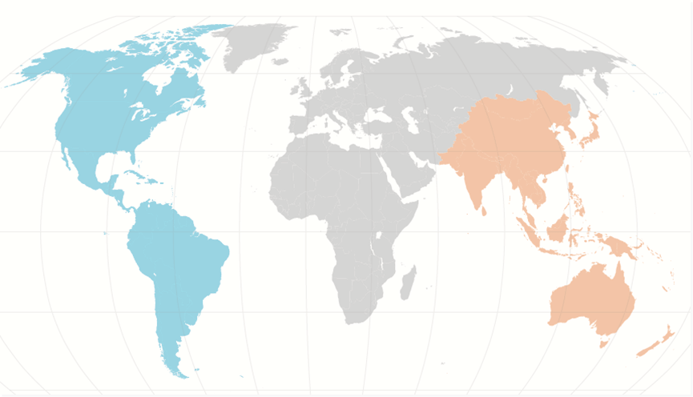
Net Sales by Regions
 | Americas | EMEA | APAC
Q4/2014 | 36.2 | 35.8 | 23.7
Change Q4/2014 Q4/2013 | +7% | +24% | +33%
Share of net sales | 38% | 37% | 25%
2014 | 112.1 | 111.8 | 75.9
Change 2014 2013 | +4% | +13% | +14%
Share of net sales | 37% | 37% | 25%
MEUR
MEUR

Slide 7
Foreign Exchange Rate Effect on Net Sales (MEUR)
Foreign exchange rate effect mainly from USD/EUR
Comparable exchange rates: translation impact eliminated
 | Q4/2014 | Q4/2013 | Q4/2014
 | Reported | Reported | At comparable exchange rates | Currency effect
Weather | 73.3 | 62.4 | 70.9 | +2.4
Controlled Environment | 22.3 | 18.0 | 21.6 | +0.8
Total | 95.7 | 80.5 | 92.5 | +3.2

Slide 8
Performance by Quarter

Slide 9
Performance by Quarter
EUR million | Q1/13 | Q2/13 | Q3/13 | Q4/13 | Q1/14 | Q2/14 | Q3/14 | Q4/14
Net sales | 65.6 | 65.2 | 61.9 | 80.5 | 57.5 | 68.7 | 77.9 | 95.7
Costs of sales | 33.6 | 32.1 | 31.9 | 41.3 | 29.8 | 34.5 | 36.8 | 45.5
Gross profit | 32.0 | 33.1 | 30.0 | 39.2 | 27.6 | 34.2 | 41.1 | 50.2
Gross margin % | 49% | 51% | 48% | 49% | 48% | 50% | 53% | 52%
Sales, marketing and administrative costs | 20.8 | 21.0 | 19.0 | 23.9 | 22.5 | 23.7 | 20.8 | 26.1
Research and development costs | 7.6 | 7.0 | 6.2 | 8.0 | 8.2 | 8.7 | 7.7 | 9.4
Other operating income and expense | 1.6 | 0.0 | 0.1 | -4.3 | 0.0 | 0.3 | 0.0 | 0.1
Operating result | 5.1 | 5.1 | 4.9 | 3.1 | -3.2 | 2.1 | 12.6 | 14.9
Operating result % | 8% | 8% | 8% | 4% | -6% | 3% | 16% | 16%

Slide 10
Weather in Q4/2014
Orders received EUR 65.4 (64.1) million, +2%
Growth came from all customer groups except Meteorology and New Weather Markets
Order book EUR 123.7 (116.2) million, +7%
Net sales EUR 73.3 (62.4) million, +17%
At comparable exchange rates net sales would have increased by 14%
Growth came from all customer groups except Airports
Net sales increased in all geographical areas except in Americas
Operating result EUR 12.7 (7.6) million, +66%

Slide 11
Controlled Environment in Q4/2014
Orders received EUR 21.7 (18.6) million, +17%
Growth came from both customer groups
Order book EUR 5.5 (5.8) million, -5%
Net sales EUR 22.3 (18.0) million, +24%
At comparable exchange rates net sales would have increased by 20%
Growth came from both customer groups
Net sales improved in all geographical areas
Operating result EUR 3.9 (-3.5) million, +212%

Slide 12
R&D Costs
R&D expenses were EUR 34.0 (28.9) million, 11.3% (10.6%) of net sales
The increase was mainly due to R&D expenses of the acquired companies, as well as investments in new offering development and renewing instrument portfolio
Weather 11.7% (11.2%) of net sales
Controlled Environment 10.3% (8.9%) of net sales

Slide 13
Overview 1-12/2014

Slide 14
Overview of 1–12/2014
Orders received EUR 295.0 (282.9) million, +4%
Net sales EUR 299.7 (273.2) million, +10%
Gross margin 51.1% (49.2%)
Operating result EUR 26.4 (18.1) million, +46%
Earning per share EUR 1.30 (0.60)
Cash flow from operating activities EUR 23.8 (28.2) million
Dividend paid EUR 16.2 (16.2) million
Vaisala’s Board of Directors is proposing a dividend of EUR 0.90 per share (0.90)

Slide 15
Foreign Exchange Rate Effect on Net Sales (MEUR)
Foreign exchange rate effect mainly from JPY/EUR and AUD/EUR
Comparable exchange rates: translation impact eliminated
 | 2014 | 2013 | 2014
 | Reported | Reported | At comparable exchange rates | Currency effect
Weather | 219.6 | 200.0 | 219.4 | +0.2
Controlled Environment | 80.2 | 73.2 | 81.4 | -1.2
Total | 299.7 | 273.2 | 300.7 | -1.0

Slide 16
Weather in 1-12/2014
Orders received EUR 215.2 (208.3) million, +3%
Orders increased in all other customer groups except in Meteorology
Order book EUR 123.7 (116.2) million, +7%
Net sales EUR 219.6 (200.0) million, +10%
At comparable exchange rates net sales would have increased by 10%
Growth came from all customer groups except Airports
Net sales improved in project and services businesses and in all geographical areas
Operating result EUR 17.0 (14.5) million, +17%
The increase was due to improved net sales and gross margins

Slide 17
Controlled Environment in 1-12/2014
Orders received EUR 79.8 (74.6) million, +7%
Orders received increased in both customer groups
Order book EUR 5.5 (5.8) million, -5%
Net sales EUR 80.2 (73.2) million, +9%
At comparable exchange rates net sales would have increased by 11%
Net sales increased in both customer groups and in all geographical areas
Operating result EUR 12.1 (4.0) million, +201%
The increase was mainly due to improved net sales and gross margins

Slide 18
Key Ratios in 2014
 | 2014 | 2013
Earnings per share, EUR | 1.30 | 0.60
Equity per share, EUR | 9.41 | 8.80
Cash flow from operating activities per share, EUR | 1.32 | 1.55
Solvency ratio | 70.6% | 71.6%
Return on equity | 14.3% | 6.3%
Capital expenditure, MEUR | 7.9 | 7.1
Personnel at the end of period | 1,613 | 1,563

Slide 19
Market and Business Outlook

Slide 20
Market Outlook 2015
The market conditions that Vaisala faces in different markets vary significantly.
Competition in weather observation market is expected to continue intensifying.
The market for industrial measurement and life science solutions is expected to remain favorable in Americas and other markets to continue flat.
The Russian economy is expected to continue weakening.
The Chinese market is expected to be somewhat slow during 2015.

Slide 21
Business Outlook 2015
Vaisala estimates its full year 2015 net sales to be in the range of EUR 285–315 million and the operating result (EBIT) in the range of EUR 20–30 million.
* Impairment charge of EUR 4.3 million

Slide 22
Restructuring for Growth

Slide 23
Key Objectives for Planned Changes
Objective
Improved ability to execute growth strategies.
Stronger alignment between business and functions, including services creation and delivery.
Improved operational efficiency enabling long-term investments in growth.
Planned action
Optimize segment and regional structure to best serve the needs of each business area.
Integrate Service into relevant BAs business management.
Simplify structure, reduce coordination points, enhance decision making and clarify roles.

Slide 24
Planned Vaisala Structure
Weather
Controlled Environment
Better support for future growth of business areas
Improved efficiency
Simplified operating model
Meteorology
Regional sales
AMER
Sales
Transportation
EMEA
Regional sales
Sales
Energy
Regional sales
APAC
Sales
Project and Customer Services
Information Services
Calibration and Repair Services
WEA Offering
CEN Offering
Operations
The organizational changes
are planned to be effective
as of April 1, 2015.
Support units

Slide 25
Vaisala Values
​​​Customer focus We strive for deep understanding of our customers' needs and aim at meeting them in everything we do.​
​Innovation and Renewal We embrace pioneering innovation and drive change through continuous improvement and learning.
Strong Together We excel by sharing, learning and working together with each other and our stakeholders.
Integrity We are honest, respectful and reliable. We promote sustainable and ethical behavior.​

Slide 26
Next Report
January-March Interim Report
Vaisala will publish its January–March Interim Report on Tuesday, April 28, 2015 at approximately 2:00 p.m. Finnish time
www.vaisala.com/investors

Slide 27
www.vaisala.com/investors

